Slide 1


DEVELOPMENT OF INTEGRATED WEARABLE DEVICE FOR REMOTE MONITORING OF PREGNANT WOMEN IN GHANA
Group Members
Owoh Einsteina Ofunne - 10943874
Anane George Nyarko – 10947340
Adika Nathaniel - 10957036
DATE: 15TH November,2024
Project Supervisor
Dr. Godfrey Mills
UNIVERSITY OF GHANA

Slide 2

OUTLINE
[1] INTRODUCTION
[2] PROBLEM TO BE SOLVED
[3] EXISTING SOLUTIONS DONE AROUND THE PROBLEM

Slide 3
INTRODUCTION
[1] Wearable devices are electronic gadgets that can be worn on the body to monitor, track, or enhance various aspects of a user's health, fitness, or daily activities.
[2] Remote Patient Monitoring is a practice that uses digital technologies to monitor and collect medical data from patients outside of traditional clinical settings, typically in their homes.
[3] Vital signs typically measured for pregnant women include temperature, heart rate, oxygen saturation, blood pressure.

Slide 4
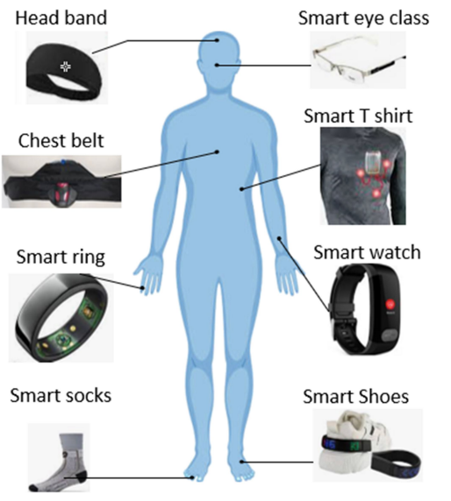
SAMPLE WEARABLE DEVICES

Slide 5
PROBLEM DEFINITION
[1] Burden on hospitals due to high influx by pregnant women
[2] Late diagnosis and untimely intervention increasing maternal and fetal mortality ratio and worsening of symptoms
[3] High Cost incurred in maternal and fetal problems.

Slide 6
EXISTING WORKS
AUTHOR | TITLE | OVERVIEW | ACHIEVED | GAP
Kaufmann et al | Feasibility of leveraging Consumer Wearable Devices with Data Platform Integration for Patient Vital Monitoring in Low-Resource Settings (2024) | Validity of Heart Rate and Oxygen Saturation against Gold Standard Clinical Monitors | Concordance between wearables-derived vital signs and gold standard vital signs | AI Integration for Predictive Analysis

Slide 7
EXISTING WORKS
AUTHOR | TITLE | OVERVIEW | ACHIEVED | GAP
Kaufmann et al | Feasibility of leveraging Consumer Wearable Devices with Data Platform Integration for Patient Vital Monitoring in Low-Resource Settings (2024) | Validity of Heart Rate and Oxygen Saturation against Gold Standard Clinical Monitors | Concordance between wearables-derived vital signs and gold standard vital signs | AI Integration for Predictive Analysis

Slide 8
EXISTING WORKS
AUTHOR | TITLE | OVERVIEW | ACHIEVED | GAP
Prince Coffie | DESIGN AND FABRICATION OF LOW-COST SYSTEM FOR VITALS MONITORING OF HOSPITALIZED PATIENTS (2021) | Developed a remote patient monitoring system to measure vitals of body temperature, pulse rate, and oxygen concentration | Alarm System in form of buzzer to alert for anomalies | Inability to send SMS to doctor or loved one who is some distance away.

Slide 9
EXISTING WORKS
AUTHOR | TITLE | OVERVIEW | ACHIEVED | GAP
Balbin Lopez et al | Wearable Technology Model to Control and Monitor Hypertension during Pregnancy (2024) | Reducing pregnancy complications related to Preeclampsia | The number of controlled patients was increased by 11% and the rate of maternal deaths was reduced by 7% | Data is collected and uploaded to cloud every 30 minutes.

Slide 10
REFERENCES
[1] Kwon, J.Y.; Park, I.Y. Fetal Heart Rate Monitoring: From Doppler to Computerized Analysis. Obstet. Gynecol. Sci. 2016, 59, 79. [CrossRef] [PubMed]
[2] Abeywardhana, S.A.Y.; Subhashini, H.A.A.; Wasalaarachchi, W.A.W.S.; Wimalarathna, G.H.I.; Ekanayake, M.P.B.; Godaliyadda, G.M.R.I.; Wijayakulasooriya, J.V.; Rathnayake, R.M.C.J. Time Domain Analysis for Fetal Movement Detection Using Accelerometer Data. In Proceedings of the 2018 IEEE Region 10 Humanitarian Technology Conference (R10-HTC), Malambe, Sri Lanka, 6–8 December 2018; pp. 1–5

Slide 11
REFERENCES
[3] J. B. Pitt, S. Zeineddin, M. Carter et al., “Using consumer wearable devices to profile postoperative complications after pediatric appendectomy,” Journal of Surgical Research, 2023.
[5] H. M. Ghomrawi, B. T. Many, J. L. Holl et al., “Clinicians' perspectives on wearable sensor technology as an alternative bedside monitoring tool in two West African countries, ” International Journal of Medical Informatics, vol. 175, article 105046, 2023.
[6]H. Akoglu, “User's guide to correlation coefficients, ” Turkish Journal of Emergency Medicine, vol. 18, no. 3, pp. 91 –93, 2018.

Slide 12
MISCELLANEOUS
QUESTIONS/FEEDBACK

